Slide 1


WELCOME

Slide 2

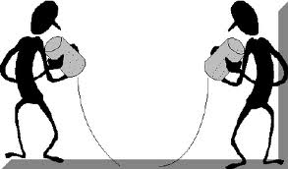
Introduction to Communication:
1. What is Communication?
2. Essentials of Communication
Prof. Dr. Ahmet SALTIK MD, Professor of Public Health
LLM; Master’s degree in Health Law – BSc; Public Admint.&Political Sciences
Atılım Univ. School of Medicine Dept. of Public Health
MED 102, Phase 1, 23.01.23, Ankara - TÜRKİYE
Notes:
Tanışma:
Katılımcılardan kendilerini istedikleri yönleri ile gruba tanıtmaları istenir. Eğitici de kendisini tanıtır.

Slide 3
Why is a course on communication skills is necessary?
Health professionals are not likely to make use of interpersonal communication skills unless
they first change their conception of the kind of relationship they want with patients.
Basic communication skills will be your keys
for not only doctor-patient relationship,
for also your inter-personal dialogues in daily life,
in school, at work.

Slide 4
Learning objectives
To give basic information about «communication» in order to improve medical communication and relations between people and health care givers. .
  Understand the importance of effective communication,
Recognize communication barriers (roadblocks),
They will become aware of the
communication barriers they frequently use.
Aim : To establish a basis of co-operation based on respect and trust between people through
effective communication.
Notes:
Eğitimin amaç ve öğrenme hedefleri sunulur

Slide 5
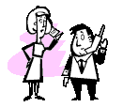
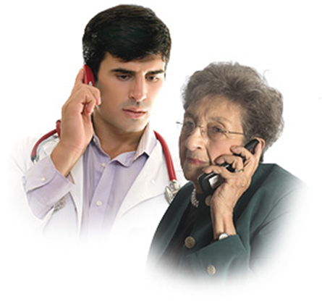

What is communication?

Slide 6
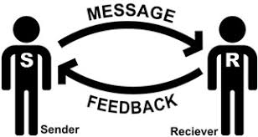
Communication is…
Communication is :
The process of sending and receiving messages through verbal or non-verbal means,
  including speech or oral communication;
  writing and graphical representations
  (such as infographics, maps, and charts..);
  and signs, signals, and behavior.
The process of exchanging thoughts, ideas, facts, emotions and opinions between two or more people.

Slide 7
CDC: Communication is Essential for Health Equity
Health Equity Guiding Principles for
Inclusive Communication emphasize the importance of addressing all people inclusively and respectfully.
These principles are intended to help public health professionals, particularly health communicators, within and outside of CDC ensure
their communication products and strategies
adapt to the specific cultural, linguistic, environmental, and historical situation
of each population or audience of focus.

Slide 8
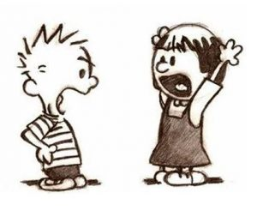
Two essential behaviors of communication
Listening & Speaking
Communication aids :
  Body language
  Clothing
  Voice tone
  Facial expressions
  Emotional expressions
  Behavior patterns

Slide 9

1.Session
Targets :
Explain the basic concepts of communication
and communication itself.
Understanding effective communication and its importance
Explain 3 behavioral patterns
Explain the concept of the Behavior Window
and influencing factors
Explaining the “Probem Window” in Communication
Understanding effective communication
and the “problem window” connection
Recognizing communication barriers
To be aware of the communication barriers
that we use frequently.

Slide 10

2.Session
Targets :
To explain the place and importance of
active listening in communication.
Making the distinction between “You & I (me) language”
Expressing the “I (me) language” correctly.
Perceiving the difference that "I (me) language/tongue"
will create in effective communication.
Explain the characteristics
that effective feedback should have.

Slide 11
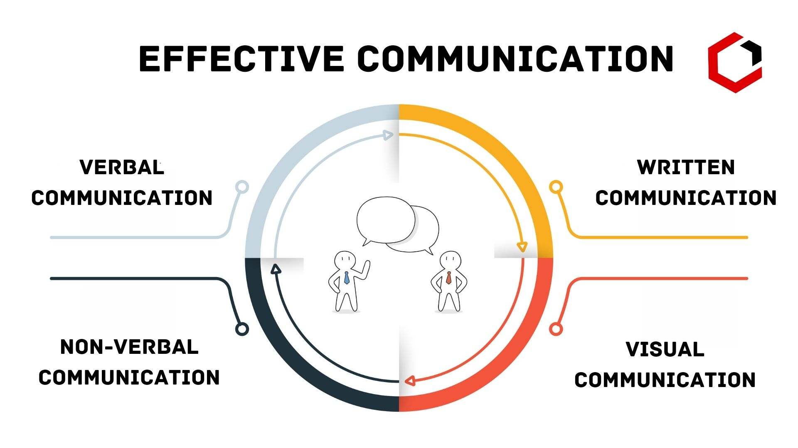

Slide 12
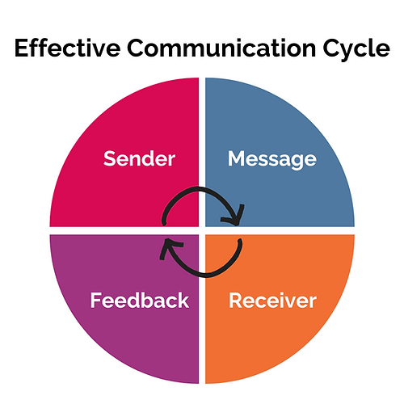
PROGRAM of the DAY
Identification of the basic components
of communication
Identifying behavioral patterns
  Passive – Agressive – Active behaviour
Behavior window
Factors affecting the behavior window
Feelings of acceptance
Understanding the “problem window” and
its connection with effective communication
Communication barriers
Evaluation of the session

Slide 13
What is communication?
It is the exchange of feelings and thoughts
between people..
Notes:
“İletişim nedir? “ sorusu yöneltildikten sonra, “ önemli midir? Neden önemlidir?” soruları ile öğrencilerin beyin fırtınası yapması sağlanır.

Slide 14
Who needs to know what I know now?
Sharing information..
Who knows what I need to know right now?
COMMUNICATION must be 2-way..

Slide 15
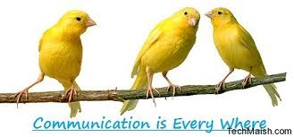
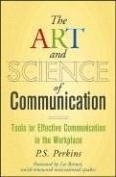
Communication tools
Speaking and listening
Body language
Clothes
Voice tone
Gestures
Emotional expressions
Behaviors (types)

Slide 16
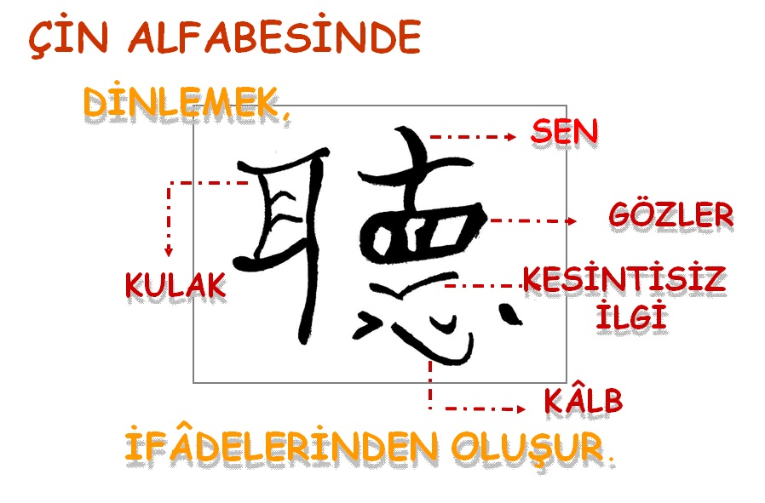
The importance of listening for successful communication

Slide 17
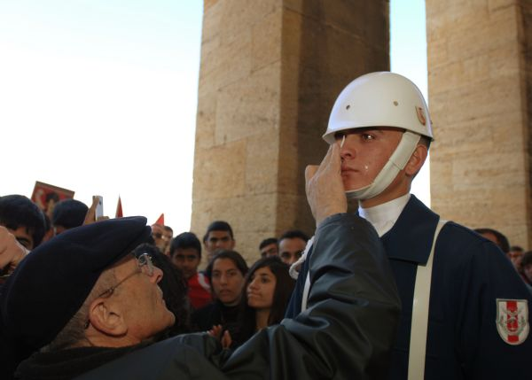
April 14, 2007 rally, Anıtkabir (Atatürk’s mosoleum)...
mass sympathy
(collective empathy) and
non-verbal communication.
1/24/2023
www.ahmetsaltik.net
17

Slide 18
Communication model
Information
Understanding
Decisions & actions
Results

Slide 19
PASSIVE BEHAVIOUR - 1
The basis : “I am insignificant, others important” (!?)
Seeing yourself as a victim in life..
Feelings and thoughts are not claimed,
and their expression is avoided..
Difficulty making decisions,
allowing others to choose for themselves.
Fear of hurting others, being rejected,
and being alone.. (introvert behaviour & personality)

Slide 20
PASSIVE BEHAVIOUR- 2
Acting in a way extreemly cautious for no conflict.
In conflict, one's own needs are easily given up.
Goals cannot be achieved.
Self-esteem drops (decreases). .
The resulting emotions are negative:
Why didn't I say this, act like that way??
Feeling guilty, angry, regretful, disappointed..
Notes:
Öğrencilerden edilgin davranış içinde oldukları ilişki tiplerini ve kişileri düşünmeleri istenir ve grup tartışması yapılır. Bu davranış durumunda neler hissettikleri sorulur.

Slide 21
AGRESSIVE BEHAVIOUR-1
Basis: “I am important, others are unimportant.”
The person who expresses his / her feelings
and thoughts is blamed, judged and labeled,
in fact, the other side is not heard.
Selections are made on behalf of someone others.
There is insensitivity to the feelings and
needs of others.
Cooperation is impossible
if it does not serve their interests. .

Slide 22
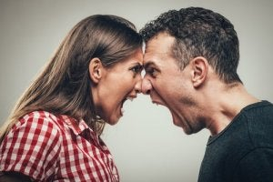
AGRESSIVE BEHAVIOUR-2
Conflict cannot be refrained & avoided..
In conflicts, only the solution
whose needs are satisfied is chosen. .
Since everything is thought to be its own right,
the rights of others are violated. .
Goals are achieved even when others are hurt.
As a result, emotions experienced are negative
  Anger, restlessness..
  “Others are always responsible
  for the negativities experienced.”
Notes:
Öğrencilerden saldırgan davranış içinde oldukları ilişki tiplerini ve kişileri düşünmeleri istenir ve grup tartışması yapılır. Bu davranış durumunda neler hissettikleri sorulur.

Slide 23
ACTIVE BEHAVIOUR-1
Basis: “I am important, others are important too.”
Direct communication is selected.
While owning and expressing feelings
and thoughts, the other party is also
allowed to express them.
The feelings and needs of her/himself
and the other person are perceived
and cared for in the same way.
Collaboration is done..

Slide 24
ACTIVE BEHAVIOUR-2
In case of conflict, the "conflict resolution" is chosen, in which both the own and the other party's needs are satisfied.
Rights are known and the other is respected.
There is problem solving..
She/He is neither passively accused nor counter-accused as an aggressor.
The resulting emotions are positive; a sense of achievement, satisfaction, happiness..

Slide 25
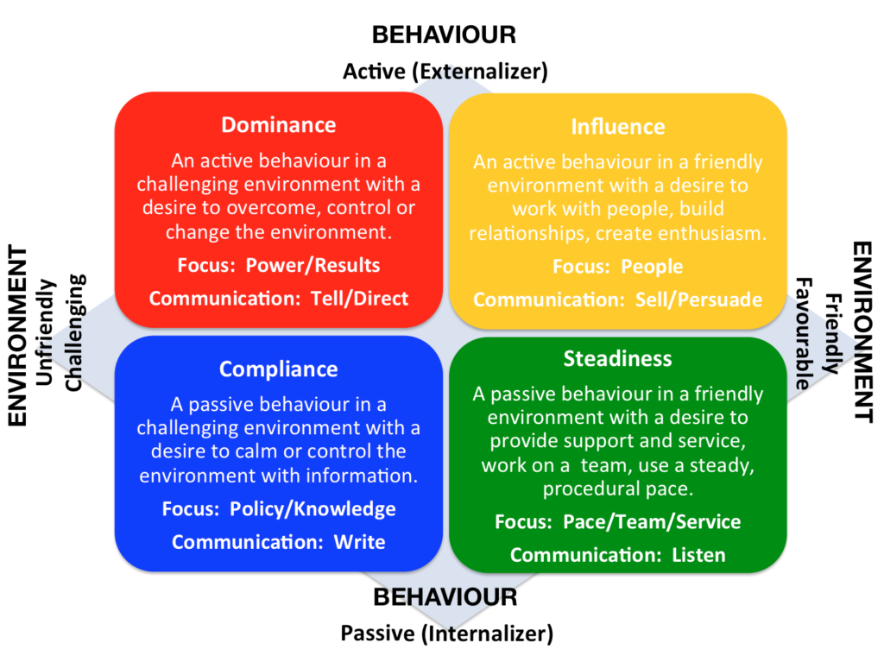
Notes:
Neden bu davranışların üzerinde durduk?
Çünkü;
Kişilik özelliği değildir, öğrenilmiş davranışlar olduğunu ve değişebileceğini vurgulamak.
Kavramları açıklamak ve doğru kullanmak.
Kendimizi değerlendirmek ve geliştirmek.
Edilgin ve saldırgan davranışlar olumsuz duygular yaşatır.

Slide 26
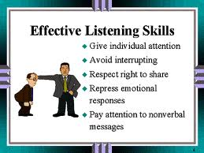
The basis of "effective communication" is to show "effective behavior.
Notes:
Neden bu davranışların üzerinde durduk?
Çünkü;
Kişilik özelliği değildir, öğrenilmiş davranışlar olduğunu ve değişebileceğini vurgulamak.
Kavramları açıklamak ve doğru kullanmak.
Kendimizi değerlendirmek ve geliştirmek.
Edilgin ve saldırgan davranışlar olumsuz duygular yaşatır.

Slide 27
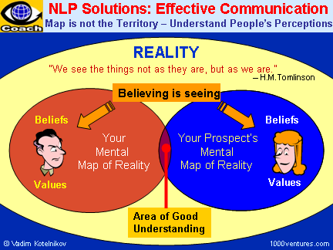
The basis of "effective communication" is to show "effective behavior.
Notes:
Neden bu davranışların üzerinde durduk?
Çünkü;
Kişilik özelliği değildir, öğrenilmiş davranışlar olduğunu ve değişebileceğini vurgulamak.
Kavramları açıklamak ve doğru kullanmak.
Kendimizi değerlendirmek ve geliştirmek.
Edilgin ve saldırgan davranışlar olumsuz duygular yaşatır.

Slide 28
BEHAVIOR WINDOW
ACCEPTABLE BEHAVIORS
B
B
B
ACCEPTANCE LINE
B
UNACCEPTABLE BEHAVIORS
B
B
Notes:
Bir davranışın kabul edilebilir olup olmadığını bizde yarattığı duygu belirler.
Kişilerin davranışlarından etkileniriz. Davranışın yargı olmadığı, bir davranışın bir insanı belirlemediği vurgulanır.
Kabul çizgisinin referansı olumsuz duygularımızdır.

Slide 29
BEHAVIOR WINDOW
Me (I)
Interlocutor
(The other side)
Environment
A
B
Notes:
Kabul çizgisini neler değiştirir?
Kabul çizgisinin iniş ve çıkışını belirleyen üç faktör:
* BEN
* KARŞISI
ÇEVRE
Kabul çizgisini değiştirmeye çalışmak yerine anlamaya çalışmak gerekir.

Slide 30
Factors affecting the behavior window
Me (I)
Personel diffrences
Current conditions
Unfinished business
…
The other party
Age
Sex
Intimacy
…
ACCEPTANCE BORDER
ACCEPT-ANCE BORDER
Environment
Physical
conditions
Cultural area
………
A
B
Notes:
Kişisel farklılıkları, kendimizdeki farklılıkları kabul etmek gerekir.

Slide 31
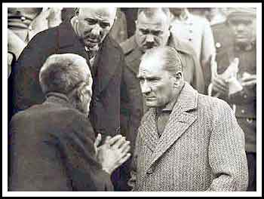
The pure human Atatürk V. The poor Turkish villager : With "deep empathy", He listens to poor man, with "sympathy", "altruism", almost "vibrating" with this older man..
21 Nov. 1930, Tokat

Slide 32
FAKE ACCEPTANCE
ACCEPTANCE BORDER
B
fake acceptance
"pretending to"
B
B

Slide 33


YOUR EMOTIONS of ACCEPTANCE (Your influence)
BEHAVIOUR | YOUR SITUATION | Your sense of acceptance
Your patient is quite late for her / his appointment. She wants
to be taken before other patients .....
That day, you stopped another study and came
to the hospital just
for this patient.
A dense and cramped day, everything comes to you
in the heavy patient traffic.
?
It's your patient check-up day, you're pretty relaxed.
You have learned about the positive results of one of your studies. You feel successful.
?

Slide 34
YOUR EMOTIONS of ACCEPTANCE (Your influence)
BEHAVIOUR | YOUR SITUATION | Your sense of acceptance
Your nurse tells you that the patient's relative wants to see you because of a mistake.
You have an important appointment and you need to go out.
You forgot to take a material that you need to take with you.
?
You’ve enough time.
You think that the information you will receive from the patient's relatives is important
in your professional career development.
?

Slide 35
YOUR EMOTIONS of ACCEPTANCE (Your influence)
BEHAVIOUR | YOUR SITUATION | Your sense of acceptance
Your friend suggests going out to dinner and then to the movies.
You have done all the work you planned and you are comfortable.
?
You are tired and angry, nothing you planned went well.
?

Slide 36
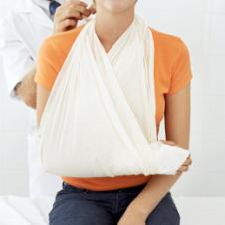
YOUR EMOTIONS of ACCEPTANCE (Your influence)
BEHAVIOUR | Situation of the other party | Your sense of acceptance
Your patient is causing problems because she is afraid of drugs and needles during her treatment.
9 years old
She can hardly swallow the drugs she takes..
?
25 years old
He knows that he needs to take the drugs...
?

Slide 37
YOUR EMOTIONS of ACCEPTANCE (Your influence)
BEHAVIOUR | Situation of the other party | Your sense of acceptance
Your patient does not understand what you are saying and constantly asks questions.
Illiterate,
came from town / village.
?
Educated, asking questions
to distract
from the topic.
?

Slide 38
YOUR EMOTIONS of ACCEPTANCE (Your influence)
BEHAVIOUR | Situation of the other party | Your sense of acceptance
You woke up to the sound of drills on the morning of
the holiday you planned to
rest at home.
The apartment management makes maintenance works without your knowledge.
?
There is repair work because the sewage pipe burst.
?

Slide 39
YOUR EMOTIONS of ACCEPTANCE (Your influence)
BEHAVIOUR | Situation of the other party | Your sense of acceptance
Your house is too small and you don't have enough closets to tidy up.
Your roommate is leaving your communal area messy.
?
Everyone has separate rooms and you had a division of labor from the beginning.
?

Slide 40
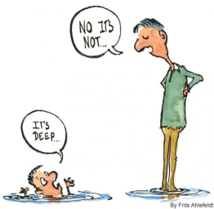
PROBLEM WINDOW
(DIAGNOSIS)
{
Other party is
experiencing problem
ACCEPTABLE
BEHAVIOURS
NO PROBLEM
ACCEPTANCE
LINE / BORDER
UNACCEPTABLE
BEHAVIOURS
I’M EXPERIENCING
PROBLEM
Notes:
İletişim iki yönlüdür. Kendimiz için kabul edilebilir bir davranış iletişimde olduğumuz kişi için de kabul edilebilir ise sorun yoktur. Ancak bizim ya da karşısı için kabul edilebilir bir davranış karşı taraf için kabul edilemez bir davranış olabilir.
Sorun penceresi, sorunun kime ait olduğunun teşhis edildiği alandır. Amaç; “sorun yok” alanını genişletmektir.
Burada sorulacak sorunun “kim rahatsız? Kimin gereksinimi engelleniyor?” sorusu olduğu vurgulanır.

Slide 41
First basic step :
Who is more bothered?
Whose requirement is blocked?
Notes:
Egzersiz:
Kimin daha rahatsız olduğu için örnekler üzerinde konuşulur.
Bunu belirlemek önemlidir çünkü sorunu yaşayan kişi belirli bir davranış şekline yönelecektir. Etkili iletişim kurmak için bunu belirlemek önemlidir.

Slide 42
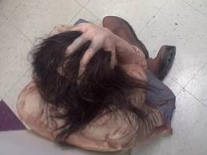
What does the person with the problem do?
Internal conversations increase
Walks away, blames
Saves - wholesaling
Goes on the defensive
Speaks with “you tongue”
Uses communication
barriers.

Slide 43
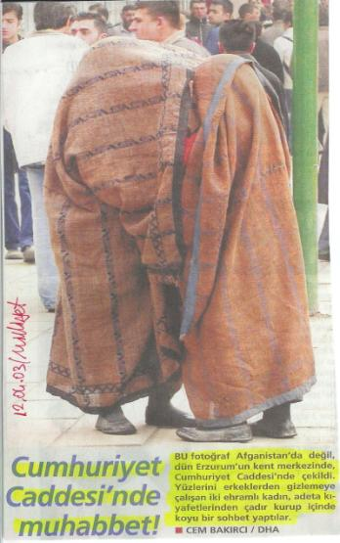
What would you say?
An extreemly peculiar
(sui generis) communication style??
Notes:
Bu alıştırma ile “iletişim engelleri”ne geçiliyor.

Slide 44
UNDERSTANDING
Comprehensive (in detail)
Correct
Rapid
In depth
Mutual

Slide 45
COMMUNICATION BARRIERS
1. ORDERING, DIRECTING
“You should do ............”, “You have to ..........”
Student - I don’t want doing this homework.
Teacher - You’ve to do this homework.
- It can create fear or active resistance;
- It may push to “try” the opposite of what is said;
- May lead to rebellious behavior or retaliation..

Slide 46
COMMUNICATION BARRIERS
2. WARNING, THREATENING (Intimidation)
“.....if you don’t ...... happens”, “Either you do or .........”
Student- I don’t want reading this book, contains mant faults.
Teacher - You’ll fail in case of not reading this book.
- Fear, and can create submission;
- May lead to “trial” whether the results in question
will actually ocur.
- It can cause resentment, anger, rebellion.

Slide 47
COMMUNICATION BARRIERS
3. GIVING ETHICAL LESSON, PREACHING
“........ you should have done ”, “your responsibility”,
“....... you should do like this.”
Student- I will not join collective regular study,
I can’t tolerate it’s load additionally either.
Teacher- You should have prepared yourself to this..
Future is your, so hapenings are under your responsibility.
- Creates feelings of obligation or guiltyness;
- It may lead the other party to defend their position
more vigorously: Who said?
- Gives the impression that the other person's sense
of responsibility is not trusted.

Slide 48
COMMUNICATION BARRIERS
4. GIVING ADVICE, GIVING SOLUTIONS
“If I were you .....”, “Why don’t do ...... in that way?”,
“According to me......”, “Let me offer you ........”
Teacher- How many more days will I be on guard duty?
It is enough!
Manager- Why don't you find something to linger
on on your computer?
- It implies that the other person is incapable of solving
their own problems.
- It prevents the other person from thinking about the problem completely, bringing different options and trying the options.
- It can also create resistance to addiction..

Slide 49
COMMUNICATION BARRIERS
5. PERSUASION by LOGIC, DISCUSSION
“Here you go, ”, “Events show thati.. ..”,
“Evet ama.......”, “The reality is this that ......”
Teacher- I beleive in postmerdern education methods.
I’m against so much lecture load.
Tutor - Yes, but post-modern education cannot keep up with
the performance and power of the system we follow.
- Provokes defensive attitudes and opposition;
- Causes the other person to cut off communication
and no longer listen;
- It can cause the other person to feel incompetent
and inadequate.

Slide 50
COMMUNICATION BARRIERS
6. JUDGING, CRITICISING, ACCUSING
“You don’t think maturatedly ....”, “You are already lazy ..........”
Parent- This time, one teacher will not be enough for you...
Student - I think you are exaggerating this test and failure..
- Feels inadequate, stupid and misevaluated .
- It causes the other person to cut off communication for fear
of being the target of a negative judgment or being scolded;
- Generally, the other person perceives the judgment and
criticism as truth. (I’m bad! etc.) or responds :
«You're not even more perfect!» etc.

Slide 51
COMMUNICATION BARRIERS
7. PRAISE, AGREE, MAKING DIAGNOSIS
“Very nice ..”, “You’re right, that person looks like
a lousy someone”
“I think you are doing a great job .....”
Student- I cannot follow this training program regularly.
My family doesn't have any support either.
Trainer - But no, your family should need to help you ......
- It implies that the other person's expectations are too high;
- It can be perceived as an insincere maneuver to make the
desired behavior happen.
- If the self-image (self-perception) of the other party and
praise are not appropriate, it may cause anxiety in the person.

Slide 52
COMMUNICATION BARRIERS
8. GIVING NICKNAME, PUTTING RIDICULOUS
“Big baby .....”, “Come on, superman...”,
“Come on, watery eyes....»
Teacher- Can't this photo be removed from class?
And do I have to pull this over the mess?
Manager- You've become a grumpy teacher ...
- It can cause the other person to feel worthless
and to think that he / she is not loved;
- It is very negative on the self-image (self-perception)
of the other person;
- It often pushes to respond..

Slide 53
COMMUNICATION BARRIERS
9. ANALYSING, MAKING DIAGNOSIS
“Do you know what's wrong with you? ”,
“You must be very tired.” “Actually you don't mean that.”
Student - I'm a prisoner to the classroom-school axis all the year.
Mother - Actually, you do it this way, not because you work hard, but because you can't go around as you enjoy. ..
- Threatening; can be unsettling and create a sense of failure
- The other person feels unprotected, trapped,
and may think that she / he is not believed;
- The counterpart (other person/party) may
cut off communication for fear of being misunderstood.

Slide 54
COMMUNICATION BARRIERS
10. CONFIDENCE, GIVING SEDATION, CONDOLENCE
“never mind.......forget it, it'll be alright .......”, “Let's cheer up
a little ......” “You'll feel better over time ........”
Student– Can't we take a break for 2 days ??
Teacher – Forget it for now, why are you rushing ?
We are giving you a nice and nice education here. .
- Makes the other person feel "not understood",
- Arouses feelings of anger (“Easy for you, of course”),
- The message of the other person is usually “Don't feel bad
about yourself. It’s not true." format is detected.

Slide 55
COMMUNICATION BARRIERS
11. EXAMINING, RESEARCH, INVESTIGATION
“Why?.... Who?..... What disd you do!?...... How?? .....”
Student – I got more stressed from my exam being postponed
one after the other..
Friend – Why do you think like that and beat yourself up?
- Because answering questions often brings criticism or compelling
solutions, the person often tends to say "no", answer half-correctly,
run away, or (may) lie.;
- As the questions often do not explain where the questioner
wants to get to, the person may become afraid and anxious;
- The person who tries to answer the questions arising
from the concerns of the other person may overlook her own problem.

Slide 56
COMMUNICATION BARRIERS
12. CHANGING SUBJECT, SYNICAL APPROACH THE JOB,
UNWARRANTED JOKING
“Let's talk about better things...”,
“Why don't you rule the world ?” (!!)
Erdem : Preparations for this festive ceremony have turned into
a never-ending symphony .
Onur : Don't take so big, think about the beautiful things
you've lived, imagine ..
- Rather than fighting life's difficulties, avoiding them may imply
the necessary message;
- It may imply that the other person's problems are unimportant,
absurd and invalid;
- When faced with a challenge, she may hesitate to act open.

Slide 57

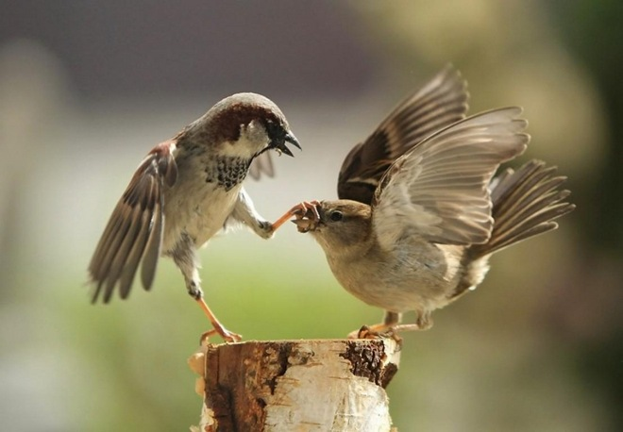
What they’re doing???

Slide 58
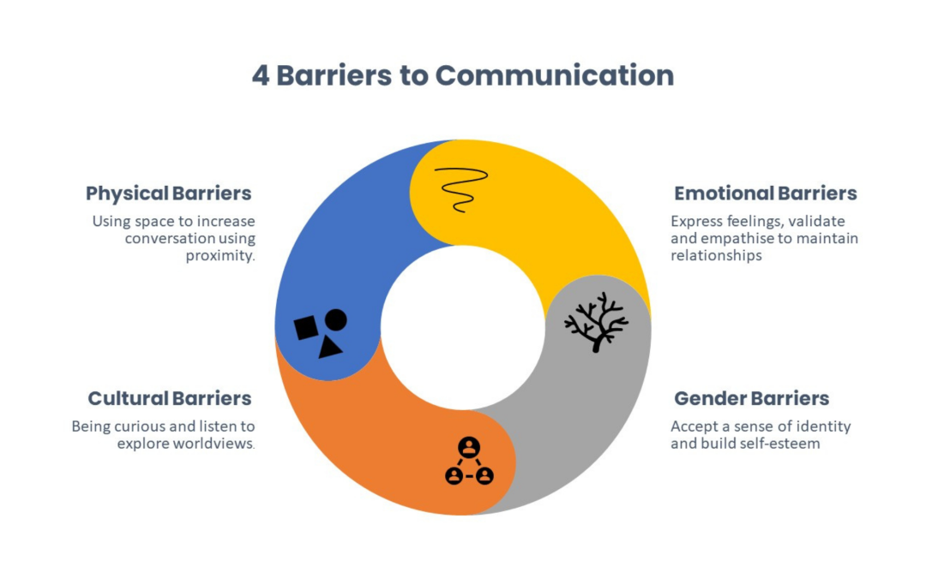

Slide 59
What are the communication barriers that we use frequently?
Would you like to make a list?
Ordering
Praising..
Accusation,
Judging
Notes:
Eve ödev verilir.
Her bir iletişim becerisi için bir örnek hazırlamaları istenir

Slide 60
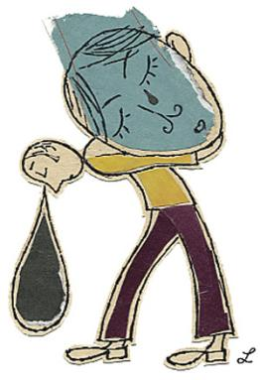
12 Communication Barriers
1. ORDERING, DIRECTING
2. WARNING, THREATENING (intimidation)
3. ETHICAL LESSON, PREACHING
4. GIVING ADVICE, GIVING SOLUTIONS
5. CONFIDENCE BY LOGIC, DISCUSSION
6. JUDJING, CRITICISM, BLAMING
7. PRAISE, AGREE, DIAGNOSIS
8. GIVING NICKNAME, MAKING RIDICULOUS
9. ANALYZING, MAKING DIAGNOSIS
10. CONFIDENCE, RELIEF, CONSOL
11. EXAMINING, RESEARCH, INVESTIGATION
12. CHANGING SUBJECT, SYNICAL APPROACH THE JOB,
UNWARRANTED JOKING

Slide 61
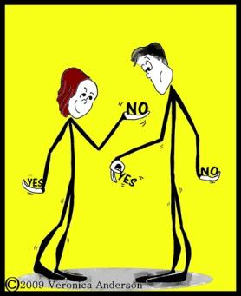
Reference Books in Turkish & English
CÜCELOĞLU, Doğan. İnsan İnsana.
CÜCELOĞLU, Doğan. ‘Keşke’siz Bir Yaşam İçin İletişim.
GORDON, Thomas. Etkili Aile İletişimi
GORDON, Thomas. Hasta Hekim İşbirliği
ÖZER Kadir. Ben Değeri Tiryakiliği
PEASE Allan. Beden Dili
SILLARS, Stuart. İletişim
DEMİRAY, Uğur (Ed.). Etkili İletişim
DÖKMEN, Üstün. İletişim Çatışmaları ve EMPATİ.
DÖKMEN, Üstün. Varolmak, Gelişmek, Uzlaşmak.
CHAPMAN, Gary. Beş Sevgi Dili.
KÖKNEL, Özcan. İnsanı Anlamak.
NAVARO, Leyla. Kadın Erkek İlişkilerinde Bir Cadı Masalı.
McCorry LK, Mason J. Communication Skills for the Healthcare Professional. ISBN-13: 978-158255814
Bayne R, Nicolson P, Horton I (Ed.s). Counselling and Communication Skills for Medical and Health Practitioners. ISBN: 978-1-854-33256-1, 1998.
Parija SC, Adkoli BV (Ed.s). Effective Medical Communication: The A, B,C, D, E of it. 1st ed. 2020.
Ray EB, Donohew L (Ed.s). Communication and Health, Systems and Applications. Routledge, 1989.
O'Toole, G. Communication: Core Interpersonal Skills for Healthcare Professionals. 4th. Ed.
ACKNOWLEDGMENT: In this presentation, the resources the late Psychologist MSc. Sema Yüce’s (ATÖLYE TEMPO) have widely been used.

Slide 62
Additional References
Roger Detels (ed.), Quarraisha Abdool Karim (ed.), Fran Baum (ed.), Liming Li (ed.), Alastair H Leyland (ed.). Oxford Textbook of Global Public Health (7 edn), 2021, Online ISBN: 9780191858383, Print ISBN: 9780198816805, https://doi.org/10.1093/med/9780198816805.001.0001
Anjali Choudhary and Vineeta Gupta. Teaching communications skills to medical students: Introducing the fine art of medical practice. Int J Appl Basic Med Res. 2015 Aug; 5(Suppl 1):
S41–S44. doi: 10.4103/2229-516X.162273
Guillermo Ferreira-Padilla, Teresa Ferrández-Antón, José Baleriola-Júlvez, Marijana Braš, and Veljko Đorđević.. Communication skills in medicine: where do we come from and where are we going?
Croat Med J. 2015 Jun; 56(3): 311–314. doi: 10.3325/cmj.2015.56.311
Laurie Kelly McCorry (Author), Jeff Mason (Author). Communication Skills for the Healthcare Professional. Enhanced Edition 2nd Edition, 2020, 978-1284219999.
Martin Gulliford, Myfanwy Morgan Routledge (Eds.). Access to Health Care. 2nd ed.2013,
Taylor & Francis Group, London and New York.
Videos, that uploaded to the Moodle system
https://www.youtube.com/watch?v=aeSlJPLFk8Q (Healthcare Communication)
How Effective Communication Can Save Lives in the Healthcare Settings
Websites John's Hopkins School of Public Health, Harvard School of Public Health, MEDLINE, WHO, NIH

Slide 63
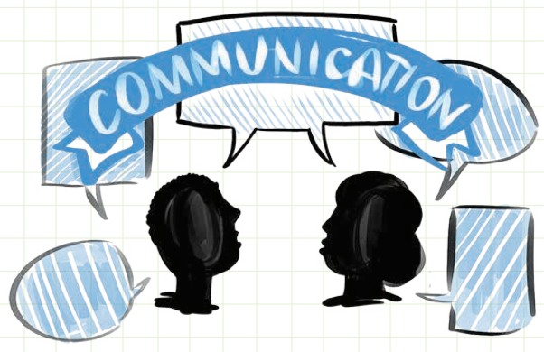

Slide 64
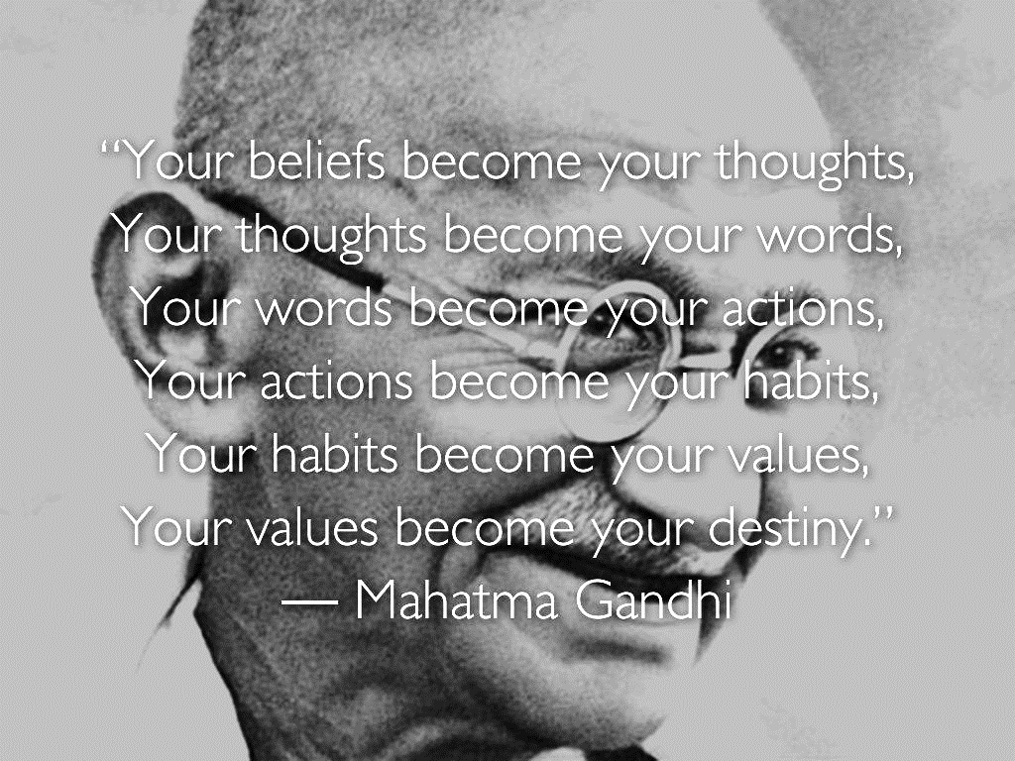

Slide 65

To all of you, who attends carefully and cooperate with me

Slide 66
