Slide 1
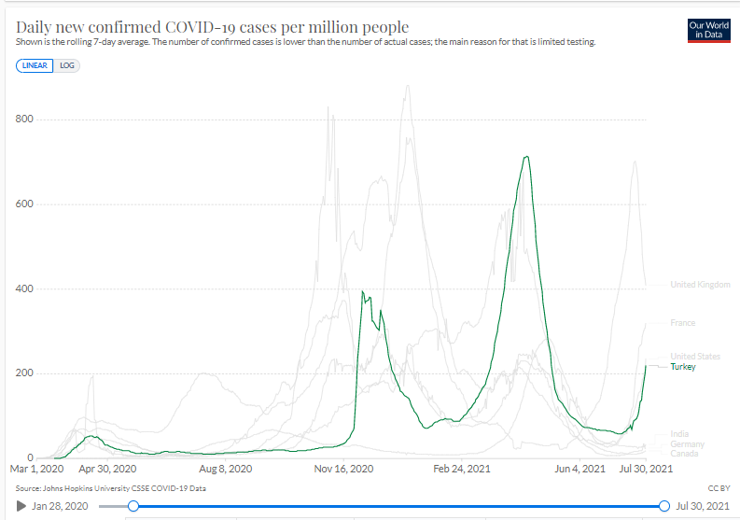
https://ourworldindata.org/covid-cases 31.07.2021
www.ahmet.saltik.net

